Slide 1
Enterprise Management System

Slide 2
Enterprise Management System
An Enterprise Management System (EMS) is a comprehensive software solution that integrates and manages a company's core business processes.
It is designed to facilitate and optimize the flow of information across all departments and functions within an organization, ensuring that operations are efficient, effective, and aligned with the company's strategic goals.
It includes various functions across the business including human resources, engineering design, production , maintenance, sales, finance, quality , research and so on.
EMS is designed to manage large volumes of critical data and to provide high levels of transaction performance and data security.
It enhances the efficiency, accuracy, and effectiveness of business operations by integrating various functions, automating routine tasks, and providing real-time data and insights.
This leads to improved decision-making, better customer service, and a more agile and responsive organization.

Slide 3
Key Features of an Enterprise Management System
Integration: Combines various business functions such as finance, HR, sales, and supply chain into a single system.
Centralized Data: Provides a unified database where all business data is stored and easily accessible.
Automation: Automates routine tasks, reducing manual work and the potential for errors.
Real-time Information: Offers real-time data and reporting capabilities to aid in decision-making.
Scalability: Can be scaled to fit the size and needs of any business, from small enterprises to large corporations.

Slide 4
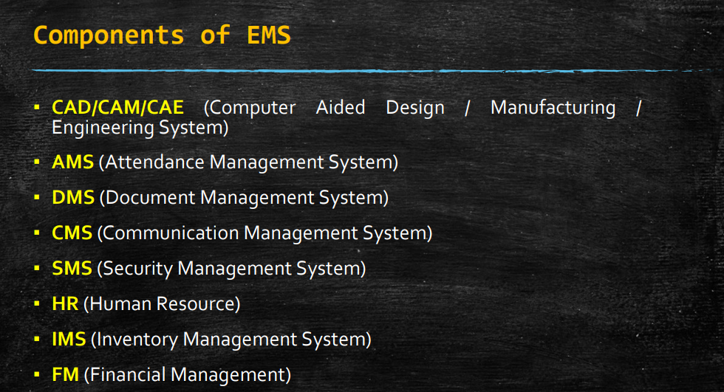
Components of EMS

Slide 5
Need for EMS
1. Integration of Business Processes
Need: Businesses often have disparate systems for different functions (e.g., finance, HR, sales, inventory).
Solution Provided by EMS: EMS integrates these systems into a single, cohesive platform, ensuring seamless data flow and process coordination across departments.
Example: An EMS can link customer orders (sales) directly to inventory management, production planning, and financial reporting, ensuring that all departments have up-to-date information.
2. Centralized Data Management
Need: Companies generate vast amounts of data, which can become siloed in different systems, leading to inefficiencies and errors.
Solution Provided by EMS: EMS centralizes data storage, providing a single source of truth for all business information.
Example: With a centralized database, a company can ensure consistency in customer records, financial reports, and inventory data, facilitating accurate reporting and analysis.

Slide 6
Need for EMS
3. Automation of Routine Tasks
Need: Manual processes are time-consuming, error-prone, and inefficient.
Solution Provided by EMS: EMS automates routine tasks such as order processing, payroll, and inventory management, reducing human error and freeing up employees for higher-value work.
Example: An EMS can automate the procurement process by triggering purchase orders when inventory levels fall below a certain threshold.
4. Real-Time Information and Reporting
Need: Timely and accurate information is crucial for decision-making in today’s fast-paced business environment.
Solution Provided by EMS: EMS provides real-time data and analytics, enabling managers to make informed decisions quickly.
Example: Real-time sales data can help a company adjust its marketing strategies on the fly, respond to customer demand more effectively, and optimize inventory levels.

Slide 7
Need for EMS
5. Enhanced Collaboration and Communication
Need: Effective communication and collaboration across departments are essential for operational efficiency.
Solution Provided by EMS: EMS facilitates better collaboration by providing shared access to information and tools.
Example: Project management modules in EMS allow teams to collaborate on projects, share documents, and track progress, ensuring everyone is aligned and informed.
6. Scalability and Flexibility
Need: As businesses grow, their systems need to adapt to increased complexity and scale. Solution
Provided by EMS: EMS is scalable, meaning it can grow with the business, accommodating more users, transactions, and data without losing performance.
Example: A small business using EMS can easily scale up its operations without needing to invest in new software as it expands its market reach and operational scope.
7. Compliance and Risk Management
Need: Regulatory compliance and risk management are critical for businesses, especially those in highly regulated industries.
Solution Provided by EMS: EMS helps ensure compliance with industry standards and regulations by maintaining accurate records and providing audit trails.
Example: An EMS can automatically update its processes to comply with new financial reporting standards or data protection regulations, reducing the risk of non-compliance penalties.

Slide 8
Need for EMS
8. Improved Customer Relationship Management
Need: Customer satisfaction and retention are crucial for business success.
Solution Provided by EMS: EMS includes CRM functionalities to manage customer interactions, sales, and support efficiently.
Example: An integrated CRM system within EMS can track customer interactions, preferences, and feedback, allowing businesses to provide personalized service and improve customer satisfaction.
9. Cost Reduction and Increased Efficiency
Need: Businesses need to optimize their operations to remain competitive.
Solution Provided by EMS: By streamlining processes, reducing manual work, and improving data accuracy, EMS helps reduce operational costs and increase efficiency.
Example: Automating the supply chain process can reduce inventory holding costs, minimize stockouts, and improve order fulfillment time

Slide 9
Enterprise Software
An Enterprise Management System (EMS) is a software package that supports the various requirements of complex organizations
An Enterprise Management System (EMS) is a comprehensive software package that caters to the many needs of larger organizations.
Enterprise software encompasses a range of applications designed to support and optimize various business functions.
Key categories of enterprise software include ERP (Enterprise Resource Planning), SCM (Supply Chain Management), and CRM (Customer Relationship Management)

Slide 10
Examples
Enterprise Management Systems (EMS) are comprehensive software solutions designed to manage and integrate various business processes across an organization
SAP ERP:
Description: SAP ERP is one of the most widely used enterprise resource planning (ERP) systems, offering modules for finance, human resources, manufacturing, supply chain management, and more.
Key Features: Extensive customization, robust integration capabilities, and support for global operations.
Oracle ERP Cloud:
Description: Oracle ERP Cloud is a comprehensive cloud-based ERP solution that includes financial management, procurement, project management, and risk management.
Key Features: Scalable cloud infrastructure, advanced analytics, and machine learning capabilities.
Microsoft Dynamics 365:
Description: Dynamics 365 combines ERP and customer relationship management (CRM) capabilities, providing solutions for finance, operations, sales, and customer service.
Key Features: Integration with other Microsoft products, flexibility, and user-friendly interface.
Odoo:
Description: Odoo is an open-source ERP system that offers a suite of business applications including CRM, sales, inventory, and project management.
Key Features: Open-source flexibility, modular approach, and affordability.

Slide 11
Four major components of EMS
Enterprise Resource Planning (ERP): Manages core business processes like accounting, procurement, project management, and supply chain operations.
Customer Relationship Management (CRM): Handles interactions with current and potential customers, improving customer service and driving sales growth.
Supply Chain Management (SCM): Optimizes the flow of goods, services, and information from suppliers to customers.
Human Resource Management (HRM): Manages employee data, payroll, recruitment, and performance evaluations.
Business Intelligence (BI): Analyzes business data to support strategic planning and decision-making.

Slide 12
Enterprise Resource Planning (ERP)
ERP systems integrate core business processes into a unified system, providing comprehensive tools for managing various functions across the organization.
Key Features:
Financial Management: General ledger, accounts payable/receivable, asset management.
Human Resources (HR): Payroll, recruiting, performance management.
Manufacturing: Production planning, shop floor control, quality management.
Procurement: Supplier management, purchase orders, invoicing.
Sales and Distribution: Order management, pricing, billing.
Example: SAP ERP
Use Case: A manufacturing company uses SAP ERP to manage its end-to-end operations, from financials and HR to production and supply chain activities. This integration ensures seamless information flow and improved operational efficiency.

Slide 13
Supply Chain Management (SCM)
SCM systems optimize the flow of goods, information, and finances as products move from suppliers to consumers. They focus on improving supply chain efficiency and effectiveness.
Key Features:
Demand Planning: Forecasting demand to optimize inventory levels.
Procurement: Managing supplier relationships and purchasing activities.
Production Planning: Scheduling manufacturing processes to meet demand.
Logistics: Managing warehousing, transportation, and distribution.
Supply Chain Visibility: Providing real-time insights into supply chain operations.
Example: Oracle SCM Cloud
Use Case: A retailer uses Oracle SCM Cloud to forecast demand, manage supplier relationships, optimize inventory levels, and ensure timely delivery of products to stores, thereby enhancing customer satisfaction and reducing operational costs.

Slide 14
Customer Relationship Management (CRM)
CRM systems manage a company's interactions with current and potential customers, focusing on improving customer service, sales, and retention.
Key Features:
Sales Automation: Manages sales processes, opportunities, and pipelines.
Customer Service: Tracks customer inquiries, service requests, and support tickets.
Marketing Automation: Manages campaigns, lead generation, and customer segmentation.
Customer Analytics: Provides insights into customer behavior and preferences.
Contact Management: Maintains comprehensive records of customer interactions.
Example: Salesforce CRM
Use Case: A tech company uses Salesforce CRM to manage its sales pipeline, track customer interactions, automate marketing campaigns, and provide exceptional customer service, leading to improved sales and customer loyalty.

Slide 15
Integration of ERP, SCM, and CRM
While ERP, SCM, and CRM systems each serve specific functions, integrating them can provide significant benefits:
Data Consistency: Ensures that information is consistent and up-to-date across all systems.
Improved Collaboration: Facilitates better communication and coordination between departments.
Enhanced Decision-Making: Provides a comprehensive view of business operations, aiding strategic planning.
Operational Efficiency: Streamlines processes and reduces duplication of effort.
Example of Integrated Solution
Microsoft Dynamics 365 is an integrated suite that combines ERP, SCM, and CRM functionalities into a single platform. It enables organizations to manage their entire business operations from a unified interface, offering modules for finance, operations, sales, customer service, and more.

Slide 16
CBIS
CBIS is an organized integration of hardware and software technologies and human resources designed to produce timely, integrated, accurate and useful information for decision making purposes.
A Computer-Based Information System (CBIS) is a comprehensive and integrated system that uses computer technology to collect, process, store, and distribute information.
CBIS supports decision-making, coordination, control, analysis, and visualization within an organization.
It is a broad term that includes various types of systems such as Management Information Systems (MIS), Decision Support Systems (DSS), Transaction Processing Systems (TPS), and more.

Slide 17
Components of CBIS
Key Components of CBIS
Hardware: The physical devices and equipment used in the information system (e.g., computers, servers, networking equipment).
Software: The programs and applications that process data and perform various functions (e.g., operating systems, database management systems, application software).
Data: The raw facts and figures that are processed into meaningful information (e.g., customer data, financial data, inventory levels).
Procedures: The policies and processes that govern the operation and use of the CBIS (e.g., data entry protocols, security measures).
People: The users who interact with the CBIS (e.g., IT staff, managers, employees).

Slide 18
Services provided by ES
Enterprise Resource Planning (ERP):
Financial Management
Human Resource Management
Supply Chain Management
Inventory Management
Production Planning and Control
Procurement
Sales and Distribution
Customer Relationship Management (CRM):
Lead Management
Opportunity Management
Contact Management
Sales Automation
Marketing Automation
Customer Support and Service
Social Media Integration

Slide 19
Services provided by ES
Supply Chain Management (SCM):
Demand Forecasting
Inventory Optimization
Supplier Relationship Management
Order Fulfillment
Logistics and Transportation Management
Warehouse Management
Procurement Management
Business Intelligence (BI):
Data Analytics
Reporting and Dashboards
Data Visualization
Performance Monitoring
Predictive Analytics
Data Mining

Slide 20
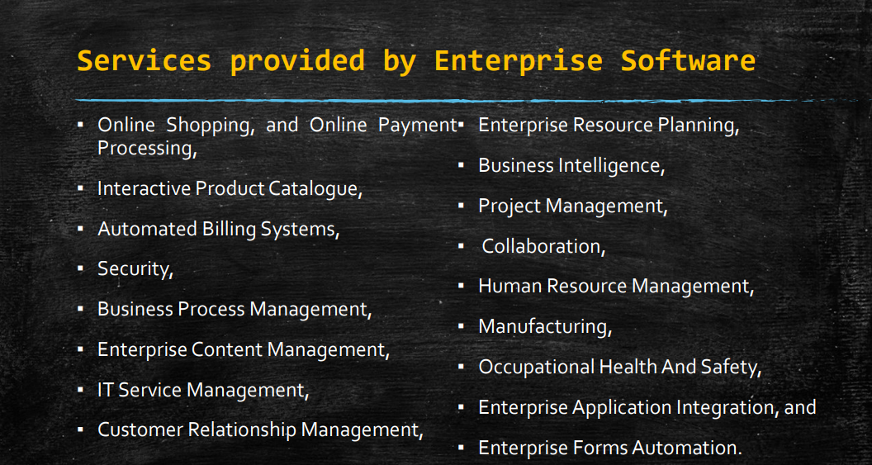
Services provided by ES

Slide 21
Enterprise System
Enterprise software refers to a category of computer programs specifically designed to address the needs of large organizations or businesses.
These software applications are complex, robust, and customizable, offering a wide range of functionalities to support various aspects of business operations, management, and decision-making.
The software is intended to solve an enterprise-wide problem, rather than a departmental problem.

Slide 22
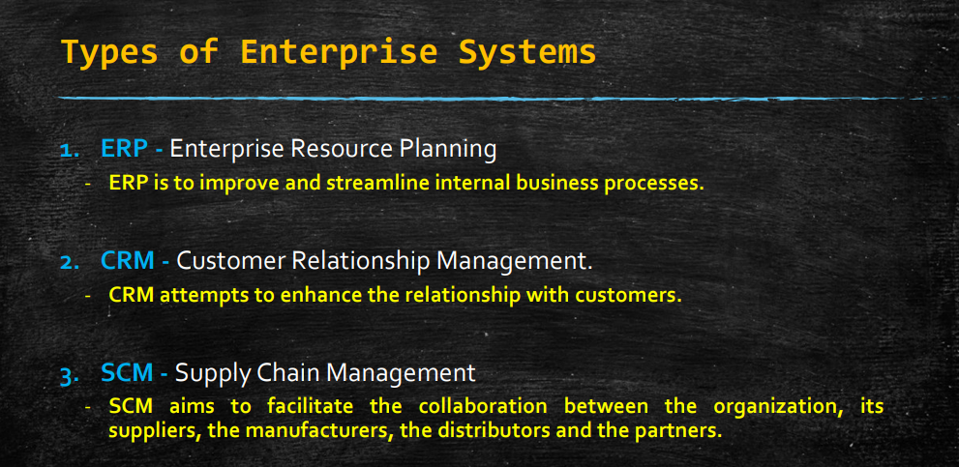
Types of Enterprise systems

Slide 23
Functional areas of ERP
Financial Management:
General Ledger: Manages financial transactions, chart of accounts, and financial reporting.
Accounts Payable: Handles vendor invoices, payments, and cash flow management.
Accounts Receivable: Manages customer invoices, payments, and credit management.
Fixed Assets: Tracks and manages the organization's fixed assets, including depreciation and asset maintenance.
Human Resource Management (HRM):
Payroll: Processes employee compensation, taxes, and benefits.
Personnel Management: Manages employee information, such as demographics, employment history, and performance evaluations.
Benefits Administration: Administers employee benefits, such as health insurance, retirement plans, and leave management.
Recruitment and Onboarding: Manages the recruitment process, including job postings, applicant tracking, and onboarding procedures.
Training and Development: Tracks employee training, certifications, and professional development activities

Slide 24
Functional areas of ERP
Sales and Marketing:
Sales Order Management: Processes customer orders, generates sales orders, and manages order fulfillment.
Customer Relationship Management (CRM): Manages customer interactions, sales pipelines, marketing campaigns, and customer service activities.
Marketing Automation: Automates marketing processes, including lead generation, email marketing, and campaign management.
Sales Forecasting: Predicts future sales based on historical data, market trends, and customer demand.
Project Management:
Project Planning: Defines project scope, objectives, deliverables, and timelines.
Resource Allocation: Assigns resources, such as personnel, equipment, and materials, to project tasks.
Budgeting and Cost Management: Estimates project costs, creates budgets, and tracks project expenses.
Task Management: Assigns tasks, monitors progress, and tracks project milestones.
Collaboration and Communication: Facilitates communication and collaboration among project team members, stakeholders, and vendors.

Slide 25
Functional areas of ERP
Quality Management:
Quality Control: Monitors and controls product quality throughout the production process.
Quality Assurance: Establishes quality standards, procedures, and processes to ensure consistent product quality.
Compliance Management: Ensures compliance with regulatory requirements, industry standards, and quality certifications.
Supply Chain Management (SCM):
Procurement: Manages the purchasing process, including requisition, vendor selection, purchase orders, and supplier management.
Inventory Management: Tracks inventory levels, manages stock movements, and optimizes inventory replenishment.
Production Planning: Plans and schedules production activities, including resource allocation, capacity planning, and material requirements planning.
Manufacturing Execution: Manages shop floor operations, including work orders, production tracking, and quality control.
Logistics and Distribution: Manages transportation, warehousing, and distribution processes to ensure timely delivery of goods to customers.

Slide 26
Benefits of ERP
Integration of Business Processes: ERP integrates all core business processes into a single system, eliminating data silos and ensuring seamless flow of information across departments.
Centralized Data Management: ERP provides a centralized database that serves as a single source of truth for all business data, ensuring data consistency and accuracy.
Improved Efficiency: By automating repetitive tasks, streamlining workflows, and eliminating manual processes, ERP improves operational efficiency and productivity.
Enhanced Decision-Making: ERP provides real-time access to accurate and up-to-date information, enabling better decision-making at all levels of the organization.
Cost Reduction: ERP helps reduce operational costs by eliminating redundant processes, optimizing resource utilization, and minimizing inventory levels.
Better Customer Service: With access to comprehensive customer data and streamlined processes, ERP enables organizations to deliver better customer service and support.

Slide 27
Benefits of ERP
Increased Agility and Flexibility: ERP systems are scalable and customizable, allowing organizations to adapt to changing business requirements and market conditions.
Regulatory Compliance: ERP systems help ensure compliance with industry regulations and standards by enforcing standardized processes and providing audit trails.
Improved Supply Chain Management: ERP streamlines supply chain processes, from procurement to distribution, resulting in better inventory management, reduced lead times, and improved supplier relationships.
Enhanced Reporting and Analytics: ERP provides robust reporting and analytics capabilities, enabling organizations to gain insights into key metrics and performance indicators for better strategic planning and decision-making.
Support for Growth and Expansion: ERP systems are designed to support organizational growth and expansion by providing scalable infrastructure and flexible functionalities.
Better Collaboration and Communication: ERP facilitates collaboration and communication among departments and teams by providing shared access to information and resources.
Standardized Processes: ERP helps standardize processes across the organization, ensuring consistency and compliance with best practices.
Improved Data Security: ERP systems incorporate robust security features to protect sensitive business data from unauthorized access, ensuring data confidentiality and integrity.
Competitive Advantage: By streamlining operations, improving efficiency, and enabling better decision-making, ERP provides organizations with a competitive advantage in the marketplace.

Slide 28
Disadvantages of ERP
High Initial Cost: ERP implementation involves significant upfront costs, including software licenses, hardware infrastructure, customization, training, and consulting fees. These costs can be prohibitive for some organizations, particularly small and medium-sized businesses.
Complexity and Customization: ERP systems are complex and require extensive customization to align with the unique processes and requirements of each organization. Customization efforts can be time-consuming, expensive, and may result in system complexity, making upgrades and maintenance challenging.
Implementation Time and Effort: ERP implementation typically requires substantial time and effort, involving multiple stages such as planning, data migration, configuration, testing, and training. Delays and disruptions during implementation can impact business operations and result in cost overruns.
Resistance to Change: ERP implementation often requires changes to existing business processes, roles, and responsibilities, which can be met with resistance from employees. Resistance to change can hinder adoption and acceptance of the new system, leading to inefficiencies and productivity losses.
Integration Challenges: Integrating ERP systems with existing legacy systems and third-party applications can be complex and challenging. Data migration, system integration, and ensuring interoperability between different systems require careful planning and execution.
User Training and Adoption: ERP systems are complex and require users to undergo comprehensive training to effectively utilize the system. User adoption may be slow, and employees may struggle to adapt to the new interface and processes, leading to inefficiencies and errors.

Slide 29
Disadvantages of ERP
Vendor Dependence: Organizations become dependent on ERP vendors for ongoing support, maintenance, and updates. Vendor lock-in can limit flexibility and increase costs, particularly if the vendor discontinues support for older versions or imposes price hikes.
Data Security Risks: ERP systems store vast amounts of sensitive business data, including financial information, customer data, and intellectual property. Security breaches, data loss, or unauthorized access to ERP systems can have severe consequences for organizations, including financial losses and damage to reputation.
Scalability Issues: ERP systems may lack scalability to accommodate rapid growth or changes in business requirements. Scaling up the system to support increased transaction volumes, users, or new business processes may require additional investments and resources.
Complexity of Upgrades: ERP upgrades can be complex and disruptive, requiring careful planning, testing, and coordination. Upgrading to newer versions may involve significant downtime, data migration, and retraining efforts, impacting business operations.
Over-Engineering: Organizations may end up over-engineering their ERP systems by implementing unnecessary features or functionalities. Over-engineering can increase costs, complexity, and maintenance efforts without delivering proportional benefits.
Cultural and Organizational Challenges: ERP implementation can disrupt organizational culture and dynamics, leading to resistance, conflicts, and morale issues. Aligning organizational goals, processes, and behaviors with the ERP system requires strong leadership and change management efforts.

Slide 30
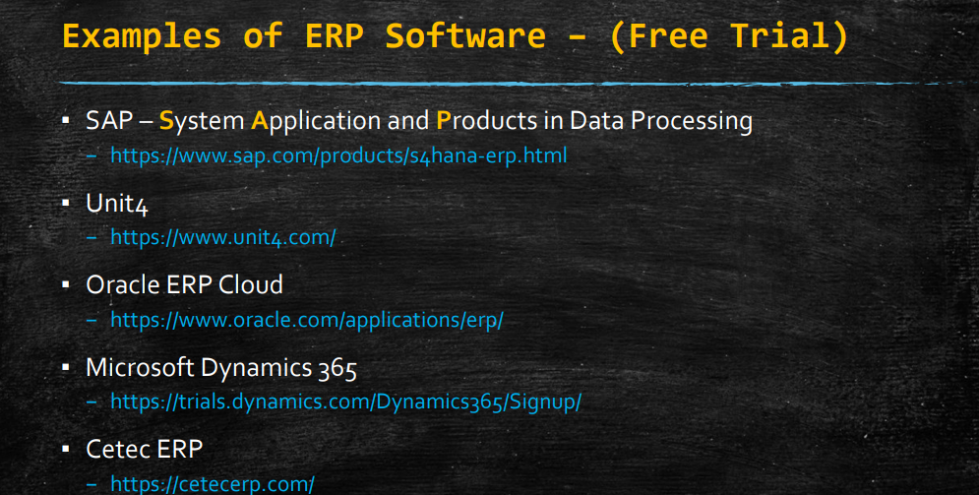

Slide 31
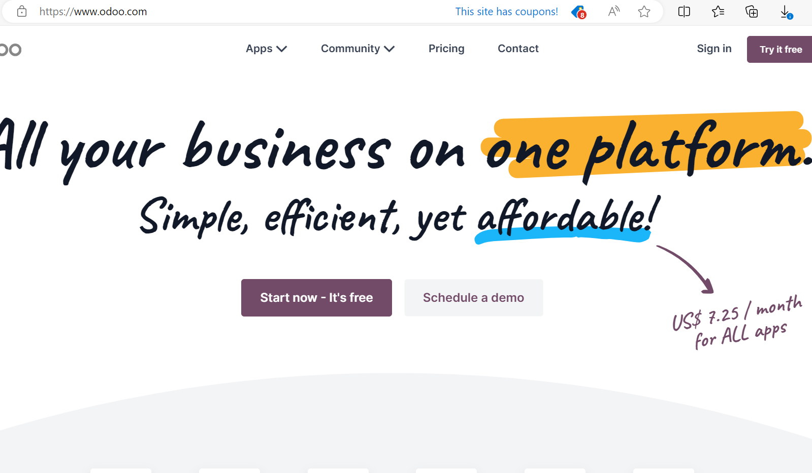

Slide 32
CRM – Customer Relationship Management
Customer Relationship Management (CRM) is a strategy and technology used by businesses to manage interactions with current and potential customers.
CRM systems help companies stay connected to customers, streamline processes, and improve profitability.
Key Features of CRM Systems:
Contact Management: Stores detailed information about customers, including contact details, communication history, and preferences.
Sales Management: Tracks sales activities, manages sales pipelines, and forecasts revenue.
Customer Service and Support: Manages customer inquiries, support tickets, and service requests, ensuring timely resolution.
Marketing Automation: Automates marketing tasks such as email campaigns, social media posting, and lead generation.
Analytics and Reporting: Provides insights into customer behavior, sales performance, and marketing effectiveness through dashboards and reports.
Integration: Integrates with other business systems (e.g., ERP, email, social media) to provide a unified view of customer interaction

Slide 33
Examples
Microsoft Dynamics 365:
Description: Combines CRM and ERP capabilities to provide solutions for sales, customer service, field service, and marketing.
Use Case: A large retail chain uses Dynamics 365 to manage customer data, track sales activities, and provide personalized customer service. Integration with other Microsoft products like Office 365 and Power BI enhances productivity and reporting.
Salesforce CRM:
Description: One of the leading CRM platforms, Salesforce offers a comprehensive suite of tools for sales, customer service, marketing, and more.
Use Case: A technology company uses Salesforce to manage its sales pipeline, track customer interactions, and automate marketing campaigns. The analytics tools help the company identify trends and optimize sales strategies.

Slide 34
Benefits - CRM
Enhanced Customer Relationships:
By centralizing customer information and interaction history, CRM systems help businesses understand their customers better, leading to more personalized and effective communication.
Improved Customer Service:
With access to detailed customer information, support teams can resolve issues more efficiently and provide a higher level of service.
Increased Sales:
CRM systems streamline the sales process, automate key tasks, and provide insights into sales performance, helping sales teams close more deals and increase revenue.
Better Marketing ROI:
Marketing automation and analytics tools help businesses run more targeted and effective marketing campaigns, leading to better return on investment.
Higher Efficiency and Productivity:
By automating routine tasks and workflows, CRM systems reduce manual work and increase overall efficiency.
Data-Driven Decision Making:
CRM systems provide valuable insights through analytics and reporting, enabling businesses to make informed decisions based on real-time data.
Improved Collaboration:
CRM systems facilitate better communication and collaboration across sales, marketing, and customer service teams, leading to more cohesive and effective strategies.

Slide 35
What does CRM do?
A Customer Relationship Management (CRM) system is a tool designed to help businesses manage and analyze customer interactions and data throughout the customer lifecycle.
Its primary goal is to improve customer service relationships, assist in customer retention, and drive sales growth.
Core Functionalities of a CRM System:
Contact Management:
Description: Centralizes and organizes customer information such as names, contact details, interaction history, and social media profiles.
Benefit: Provides a comprehensive view of each customer, enabling personalized interactions and improved customer service.
Sales Management:
Description: Manages the sales pipeline, tracks sales activities, and forecasts revenue. Helps in managing leads, opportunities, and deals.
Benefit: Streamlines the sales process, improves sales team productivity, and enhances the accuracy of sales forecasts.

Slide 36
What does CRM do?
Customer Service and Support:
Description: Manages customer inquiries, support tickets, and service requests. Includes tools for case management and knowledge base.
Benefit: Ensures timely and effective resolution of customer issues, improving customer satisfaction and loyalty.
Marketing Automation:
Description: Automates marketing tasks such as email campaigns, social media postings, lead generation, and lead nurturing.
Benefit: Increases marketing efficiency, enhances targeting and personalization, and improves campaign effectiveness.
Workflow Automation:
Description: Automates routine tasks and workflows, such as sending follow-up emails, scheduling calls, and updating records.
Benefit: Reduces manual workload, ensures consistency in processes, and frees up time for more strategic activities.
Analytics and Reporting:
Description: Provides tools for generating reports and dashboards, analyzing customer data, and tracking performance metrics.
Benefit: Offers insights into customer behavior, sales performance, and marketing effectiveness, supporting data-driven decision-making.
Integration:
Description: Integrates with other business systems such as email, ERP, social media, and e-commerce platforms.
Benefit: Creates a unified view of customer data, enhances data accuracy, and improves cross-departmental collaboration.
Mobile Access:
Description: Offers mobile applications to access CRM data and functionalities on the go.
Benefit: Enables sales and service teams to stay connected and productive from anywhere.

Slide 37
Disadvantages - CRM
High Cost:
Description: Implementing and maintaining a CRM system can be expensive, especially for small and medium-sized businesses.
Impact: Costs include software licenses, hardware, customization, integration, training, and ongoing support and maintenance.
Complexity:
Description: CRM systems can be complex and require significant time and resources to set up and manage.
Impact: The complexity may lead to a steep learning curve for employees, potentially causing resistance to adoption and underutilization of the system.
Integration Issues:
Description: Integrating a CRM system with existing business processes and other software systems (like ERP, marketing automation, and email platforms) can be challenging.
Impact: Poor integration can result in data silos, inefficiencies, and errors, undermining the effectiveness of the CRM system.
Data Privacy and Security:
Description: CRM systems store sensitive customer data, making them targets for cyberattacks and data breaches.
Impact: Inadequate security measures can lead to data loss, regulatory fines, and damage to the company’s reputation.
User Adoption Issues:
Description: Employees may be resistant to adopting a new CRM system due to its perceived complexity or disruption to their existing workflows.
Impact: Low user adoption can prevent the organization from realizing the full benefits of the CRM system.

Slide 38
Disadvantages - CRM
Customization and Flexibility:
Description: Customizing a CRM system to fit specific business needs can be time-consuming and expensive.
Impact: Inadequate customization may result in a system that doesn’t fully meet the organization’s requirements, leading to inefficiencies and dissatisfaction.
Maintenance and Upkeep:
Description: Regular maintenance, updates, and troubleshooting are necessary to keep the CRM system running smoothly.
Impact: These tasks can consume significant IT resources and time, potentially diverting attention from other critical projects.
Over-Reliance on Technology:
Description: Businesses might become overly dependent on their CRM systems, neglecting the importance of personal interactions and relationship-building.
Impact: This can lead to a less personalized customer experience and reduced customer satisfaction.
Inaccurate Data:
Description: CRM systems rely on accurate data entry and maintenance. Incomplete or incorrect data can lead to misleading insights and poor decision-making.
Impact: Data inaccuracies can undermine the effectiveness of the CRM system, leading to missed opportunities and inefficient processes.
Training Requirements:
Description: Effective use of a CRM system requires thorough training for all users.
Impact: Training programs can be time-consuming and costly, and the need for ongoing training can be a continual burden.

Slide 39
Examples - CRM
1. Salesforce
Description: Salesforce is one of the most widely used CRM platforms globally, offering a comprehensive suite of tools for sales, customer service, marketing, and more.
Key Features: Sales automation, customer service management, marketing automation, analytics, and custom app development.
Ideal For: Businesses of all sizes, from small startups to large enterprises.
2. HubSpot CRM
Description: HubSpot CRM is known for its user-friendly interface and robust marketing automation features. It offers a free version with essential CRM functionalities.
Key Features: Contact management, email tracking, deal tracking, live chat, and marketing automation.
Ideal For: Small to medium-sized businesses and startups
3. Microsoft Dynamics 365
Description: Microsoft Dynamics 365 combines CRM and ERP capabilities to provide solutions for sales, customer service, field service, and marketing.
Key Features: Sales automation, customer service tools, field service management, AI-driven insights, and integration with other Microsoft products.
Ideal For: Medium to large enterprises, especially those already using other Microsoft products.

Slide 40
Maximizer Best CRM Software for Small Businesses & Teams - Maximizer CRM

Slide 41
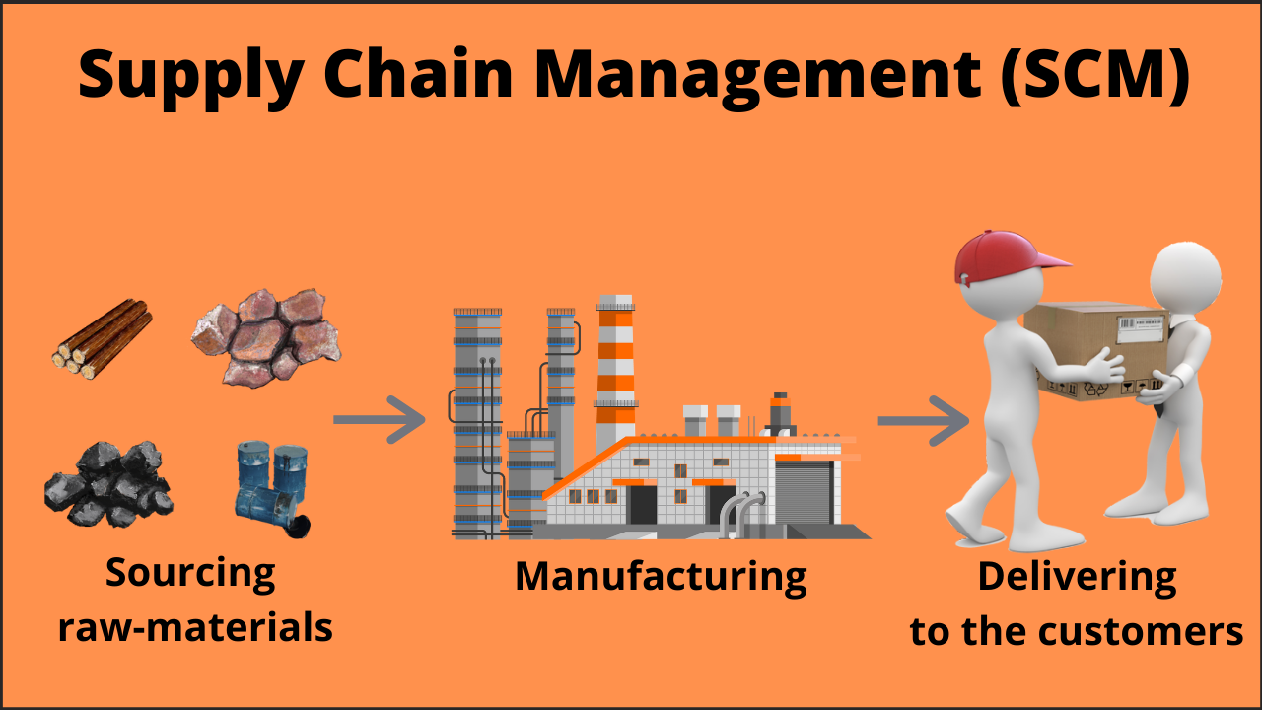

Slide 42
SCM – Supply Chain Management
Supply Chain Management (SCM) is the oversight and management of the flow of goods and services, including all processes that transform raw materials into final products.
It involves the active streamlining of a business's supply-side activities to maximize customer value and gain a competitive advantage in the marketplace.
Key Components of Supply Chain Management:
Planning: Determining what resources are needed to meet customer demands, including inventory levels, production schedules, and transportation logistics.
Sourcing: Selecting suppliers that provide the goods and services needed to create the product. This includes negotiating contracts and monitoring supplier performance.
Manufacturing: Converting raw materials into finished products through a series of processes and operations.
Delivery and Logistics, marketing: Managing the transportation and storage of goods to ensure timely delivery to customers.
Return and Reverse Logistics: Handling returns and exchanges, including managing the reverse flow of goods

Slide 43
Examples - SCM
Apple Inc.:
Description: Apple is renowned for its efficient supply chain management, which is integral to its success in the electronics industry.
Example: Apple coordinates with numerous suppliers worldwide for components like processors, screens, and batteries. The company uses advanced forecasting and inventory management to ensure timely product launches and availability.
Benefit: This efficient SCM allows Apple to minimize costs, reduce lead times, and maintain high product quality.
Amazon:
Description: Amazon's SCM is a cornerstone of its ability to provide fast and reliable delivery services.
Example: Amazon uses advanced algorithms for demand forecasting and inventory placement. It has a vast network of fulfillment centers strategically located to optimize delivery times.
Benefit: This allows Amazon to offer same-day or next-day delivery, enhancing customer satisfaction and loyalty.

Slide 44
Benefits - SCM
Cost Reduction: Efficient SCM helps in minimizing costs associated with production, transportation, and storage.
Improved Efficiency: Streamlined processes reduce lead times and increase productivity.
Better Quality Control: Close coordination with suppliers ensures high-quality raw materials and components.
Customer Satisfaction: Timely delivery of products enhances customer satisfaction and loyalty.
Risk Mitigation: Proactive SCM practices help in identifying and mitigating risks related to supply disruptions, market changes, and other uncertainties.

Slide 45
Challenges in SCM
Demand Variability: Fluctuations in customer demand can complicate inventory management and production planning.
Globalization: Managing a global supply chain involves navigating different regulatory environments, cultural differences, and logistical complexities.
Technology Integration: Implementing and maintaining advanced SCM technologies can be costly and require continuous updates and training.
Sustainability: Increasing pressure to adopt environmentally sustainable practices can complicate supply chain operations.
Supplier Reliability: Dependence on suppliers can pose risks if they face disruptions or fail to meet quality standards.

Slide 46
EIM- Enterprise Information Management
Enterprise Information Management (EIM) refers to the comprehensive framework and strategy used by organizations to manage, optimize, and leverage their data and information assets across the enterprise.
The goal of EIM is to ensure that data is accurate, consistent, accessible, and secure, thereby enabling informed decision-making and operational efficiency.
EIM is a set of technologies and practices that maximize the value of information as it flows across the enterprise.

Slide 47
Components of EIM
Data Governance:
Establishes policies and procedures for managing data quality, integrity, and security.
Ensures compliance with regulations and standards.
Data Integration:
Combines data from different sources into a unified view.
Facilitates seamless data flow across systems and departments.
Data Quality Management:
Ensures data accuracy, completeness, and reliability.
Involves data cleansing, validation, and enrichment processes.
Master Data Management (MDM):
Manages key business entities (customers, products, employees) to ensure a single, consistent view.
Enhances data consistency across the organization.

Slide 48
Components of EIM
Content Management:
Manages unstructured data (documents, emails, videos) and structured data.
Involves storage, retrieval, and lifecycle management of content.
Information Security:
Protects data from unauthorized access and breaches.
Implements encryption, access controls, and security policies.
Business Intelligence (BI) and Analytics:
Analyzes data to provide insights for decision-making.
Uses tools for reporting, dashboards, and predictive analytics.
Data Architecture:
Defines the structure and design of data systems.
Ensures data is stored and processed efficiently.

Slide 49
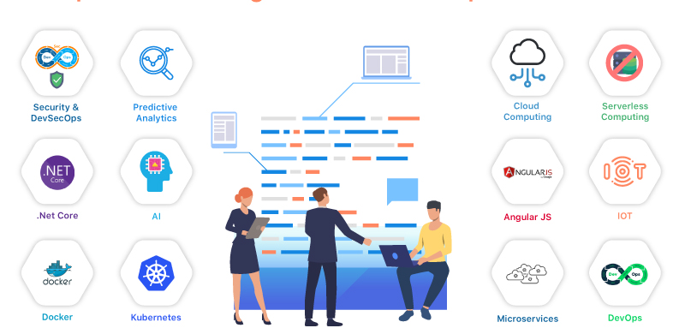
Top 10 technologies to build enterprise software

Slide 50
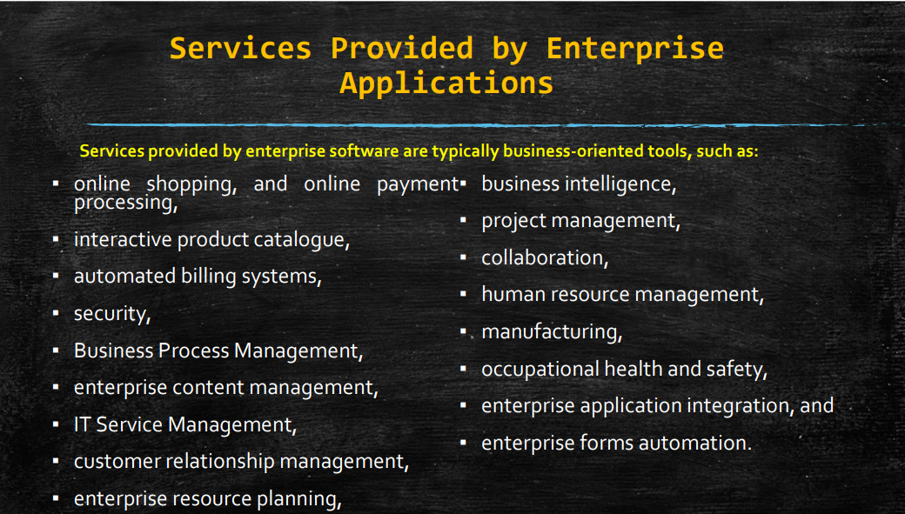

Slide 51
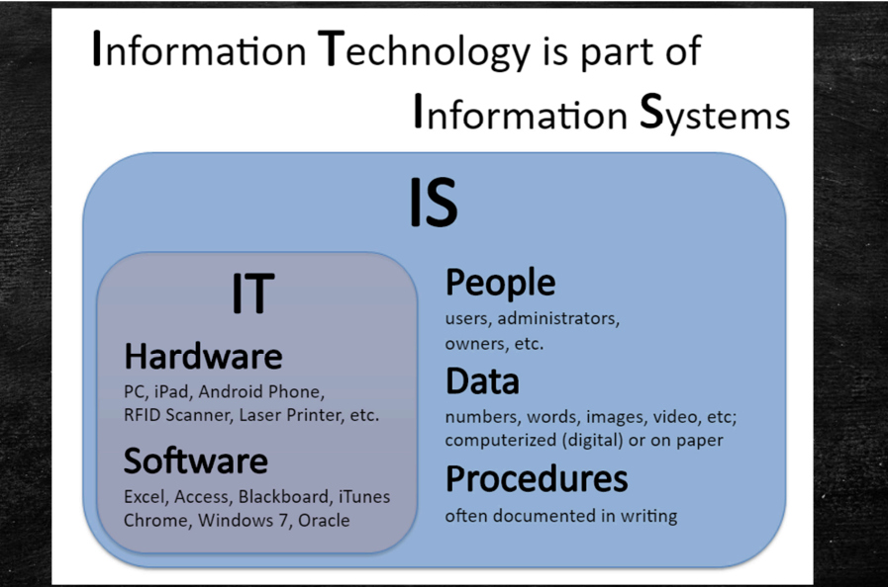
Role of IS and IT in Enterprise Management

Slide 52
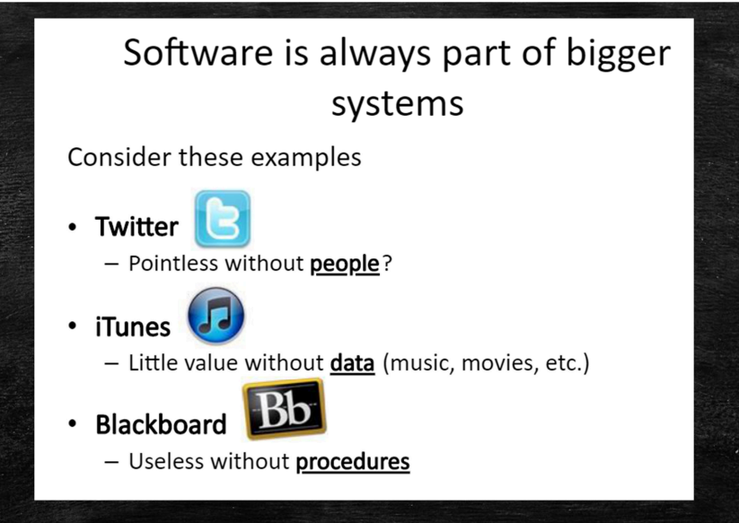

Slide 53
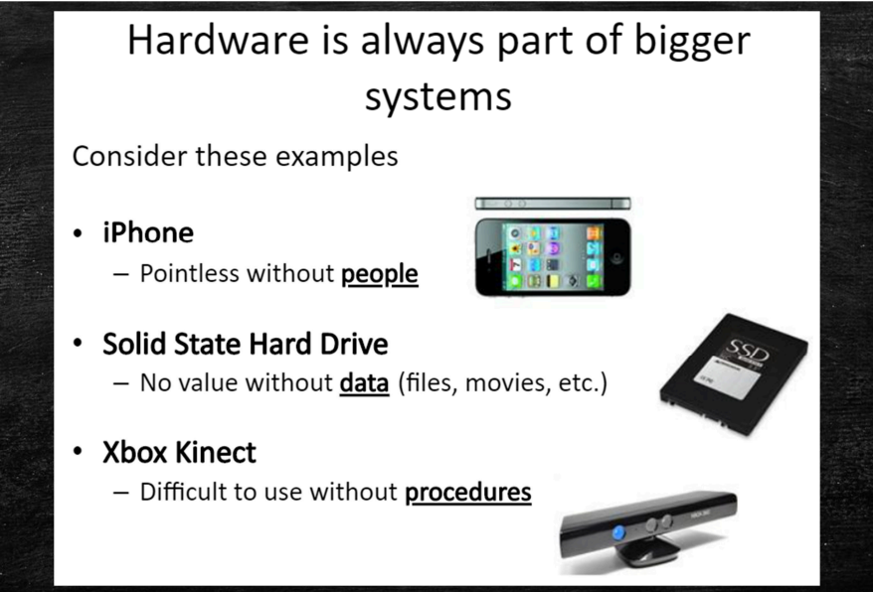

Slide 54
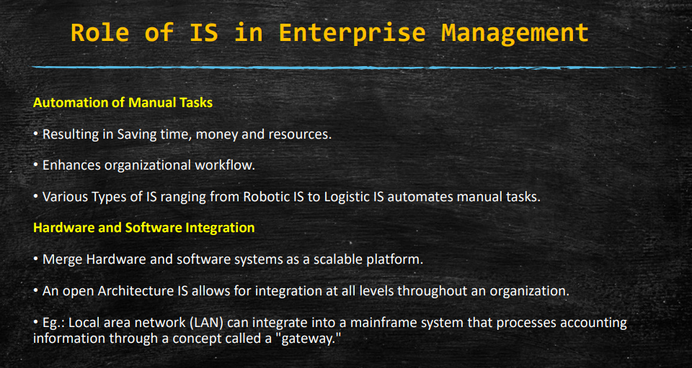
Role of IS in Enterprise Management

Slide 55
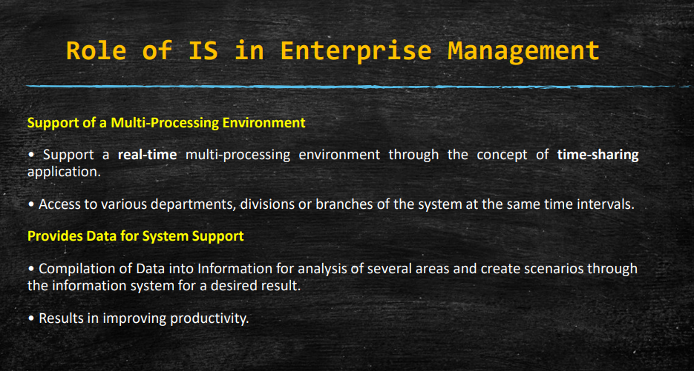
Role of IS in Enterprise Management

Slide 56
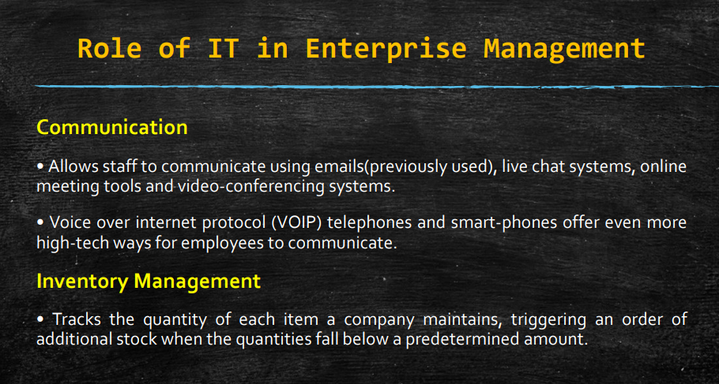

Slide 57
